Slide 1
Development of the mathematic model of disymmetric bigram cryptosystem based on a parametric solution family of multi-degree system of Diophantine equations
Valeriy O. Osipyan Kuban State University Russian Federation v.osippyan@gmail.com | Kirill I. Litvinov Kuban State University Russian Federation lyrik-1994@yandex.ru

Slide 2
Diophantine Equation
$$f\left(x_{1},x_{2},…,x_{n}\right)=0$$
In the paper we will consider the next type of Diophantine Equaltion system:
$$\left\{\begin{aligned}X_{1}+X_{2}+…+X_{m}=Y_{1}+Y_{2}+…+Y_{m} \\ … \\ X_{1}^{n}+X_{2}^{n}+…+X_{m}^{n}=Y_{1}^{n}+Y_{2}^{n}+…+Y_{m}^{n}\end{aligned},n<m\right.$$
or in short notation
$X_{1},X_{2},…,X_{m}\overset{n}{=}Y_{1},Y_{2},…,Y_{m}; X^{m}\overset{n}{=}Y^{m}$.
Solution of the equation system can be written in the form
$a_{1},a_{2},…,a_{m}\overset{n}{=}b_{1},b_{2},…,b_{m}$ $; A^{m}\overset{n}{=}B^{m}$.

Slide 3
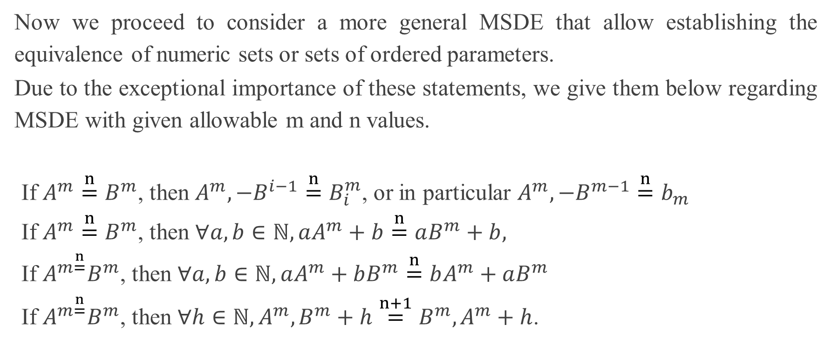
MSDE Solutions Properties
Now we proceed to consider a more general MSDE that allow establishing the equivalence of numeric sets or sets of ordered parameters.
Due to the exceptional importance of these statements, we give them below regarding MSDE with given allowable m and n values.
If $A^{m}\overset{n}{=}B^{m}$, then $A^{m},−B^{i−1}\overset{n}{=}B_{i}^{m}$, or in particular $A^{m},−B^{m−1}\overset{n}{=}b_{m}$
If $A^{m}\overset{n}{=}B^{m}$, then $∀a,b∈ℕ, aA^{m}+b\overset{n}{=}aB^{m}+b,$
If $A^{m\overset{n}{=}}B^{m}$, then $∀a,b∈ℕ, aA^{m}+bB^{m}\overset{n}{=}bA^{m}+aB^{m}$
If $A^{m\overset{n}{=}}B^{m}$, then $∀h∈ℕ, A^{m},B^{m}+h\overset{n+1}{=}B^{m},A^{m}+h$.

Slide 4
PARAMETERIZATION METHOD FOR MULTI-DEGREE SYSTEMS
Let us demonstrate the parameterization method for MSDE of $m$ dimension and $n$ order $X^{m}\overset{n}{=}Y^{m}, n<m$
A family of two-parameter solutions of MSDE $X^{6}\overset{n}{=}Y^{6}, n=1,2,4,6$ can be found as:
$$X_{1}=5a+b,X_{2}=a−5b,X_{3}=7a+5b,$$
$$X_{4}=5a−7b,X_{5}=2a+8b,X_{6}=8a−2b,$$
A family of three-parameter solution of MSDE: $X^{4}\overset{n}{=}Y^{4}, n=2,4,6$
$$X_{1}=a−7c,X_{2}=3a+c,X_{3}=a−2b+c,X_{4}=3a+2b+c,$$
$$Y_{1}=a+7c,Y_{2}=3a−c,Y_{3}=a−2b−c,Y_{4}=3a+2b−c,$$

Slide 5
Mathematical model of cryptosystem on the basis of Diophantine equation
Proposed cryptosystem is based on the Diophantine equation system of the form:
$$X_{1},X_{2},…,X_{l}\overset{k}{=}Y_{1},Y_{2},…,Y_{l},$$
Let’s the system has the following parametric solution
$$X_{i}=v_{i}, i=1..l,$$
$Y_{i}=v_{j}, j=l+1..2l$,
$$v_{1},v_{2},…,v_{l}\overset{k}{=}v_{l+1},…,v_{2l};$$
$$v_{1},v_{2},…,v_{l},−v_{l+1},…,{−v}_{2l−1}\overset{k}{=}v_{2l}$$
$$E\left(m_{i}m_{i+1}\right)=C_{L}=v_{1}^{k}+…+v_{l}^{k}−v_{l+1}^{k}−…−v_{2l}^{k}$$
$D\left(c_{i}\right)−$solution of equation $v_{2l}^{k}=C_{L}$

Slide 6
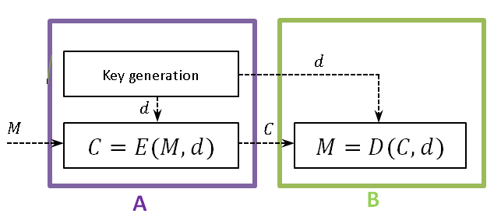
MATHEMATICAL MODEL OF ALPHABETIC DBC BASED ON 2-PARAMETER SOLUTION
Let’s the system has the following parametric solution
$$X_{i}=v_{i}\left(a,b\right)=v_{i}, i=1..l,$$
$Y_{i}=v_{j}\left(a,b\right)=v_{j}, j=l+1..2l$,
M – is a numeric equivalent of message (or message’s block)
$M=27q_{i}+q_{i+1}, q_{i}, q_{i+1}$– numeric equivalents of $m_{i}, m_{i+1}$
d – is a secret key
Encryption algorithm:
$$C=E\left(m_{i}m_{i+1}\right)=C_{L}\left(M,d\right)=v_{1}^{k}+v_{2}^{k}+…+v_{l}^{k}−v_{l+1}^{k}−…{−v}_{2l−1}^{k}$$
Decryption algorithm:
$$M−\text{solution} \text{o}\text{f} \text{equation} v_{2l}^{k}=C$$

Slide 7
MATHEMATICAL MODEL OF ALPHABETIC DBC BASED ON 3-PARAMETER SOLUTION
Let’s the system has the following parametric solution
$$X_{i}=v_{i}\left(a,b,c\right)=v_{i}, i=1..l,$$
$Y_{i}=v_{j}\left(a,b,c\right)=v_{j}, j=l+1..2l$,
$q_{i}, q_{i+1}$– numeric equivalents of $m_{i}, m_{i+1}$
d – is a secret key
Encryption algorithm:
$$C=E\left(m_{i}m_{i+1}\right)=C_{L}\left(q_{i},q_{i+1},d\right)=v_{1}^{k}+v_{2}^{k}+…+v_{l}^{k}−…{−v}_{2l−1}^{k}$$
Decryption algorithm:
$$M−\text{solution} \text{o}\text{f} \text{equation} v_{2l}^{k}=C$$

Slide 8
Conclusion
As the work progressed, the following results were obtained:
We developed a mathematical model of DBC containing Diophantine difficulties in solving MSDE of given dimension and order. As noted above, to determine the numeric equivalents of elementary messages, a legal user solves a simple equation of given degree, but an illegal user solves a multivariable MSDE of given dimension and order
A new approach to the development of DBC based on the parametric solution of MSDE is proposed that generalizes the principle of building the public key cryptosystems: for direct and inverse transformations of the processed information, the parametric solution of MSDE is preliminarily divided into two parts: one part is used according to the given algorithm for direct transformation of the plain text, and the other part - for reverse transformation of the closed text using blocks of given length, for example, bigrams.

Slide 9
Thank you for your attention!

